Slide 1
Additional points
Apparatus
Current sources
How dim can an LED glow? A tale from Amgen
Lessons learned
Electronics Review

Slide 2
Comment on apparatus
Although I have at my disposal a lot more tools, apparatus, and components than you do, I’ve tried to develop this curriculum using only the stuff that you have, except:
My Arduino is plugged into a $13 USB current meter:
https://www.amazon.com/MakerHawk-3-7-30V-Voltage-Multimeter-Voltmeter/dp/B07FMQZVW2
I also tried a cheaper one that didn’t work …
I use a better soldering iron: https://www.amazon.com/gp/product/B09DKQPDKB/ costs $43 and is quite nice (so far)
https://www.amazon.com/Weller-WE1010NA-Digital-Soldering-Station/dp/B077JDGY1J/ is probably nicer, I’ve used old Weller irons purchased on ebay too

Slide 3
Measuring R_{Th}
The Wikipedia page gives a theoretical recipe that isn’t generally safe or practical
R_{Th} isn’t a real, fixed R, but an equivalence who’s value may likely change as the operating point of the circuit changes.
We therefore want to measure R_{Th} “close” to where we’ll be operating the device

Slide 4
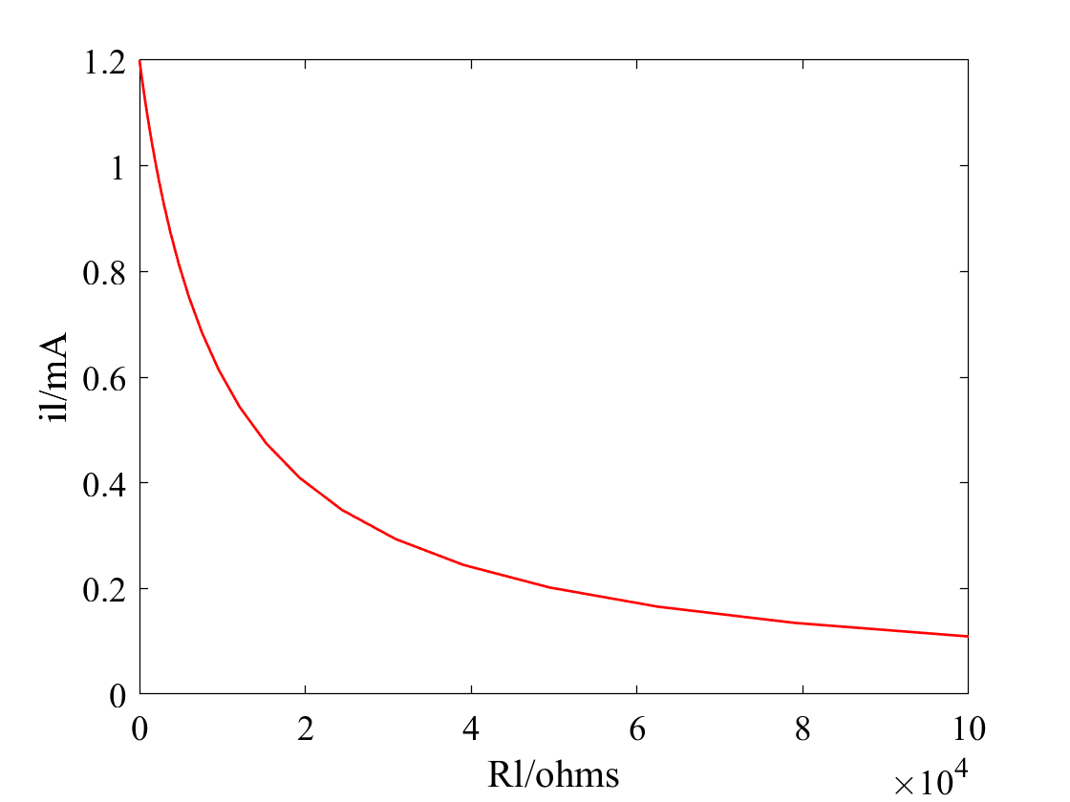
Making a constant current source
Sidetrack
#1
Let’s simulate the circuit at right, for a range of different R_{L}s. Here’s (our first) Matlab code:
V0 = 12; % volts
Rs = 10e3; % ohms
Rl = logspace(0,5)'; % ohms
Vl = V0 * Rl ./ (Rs+Rl); % voltage divider eqn
il = Vl ./ Rl * 1000; % mA
plot(Rl, il)
xlabel('Rl/ohms');
ylabel('il/mA')
Doesn’t look like a constant current …
What if we just change the scale to log-log
R_{S}
V₀
R_{L}

Slide 5
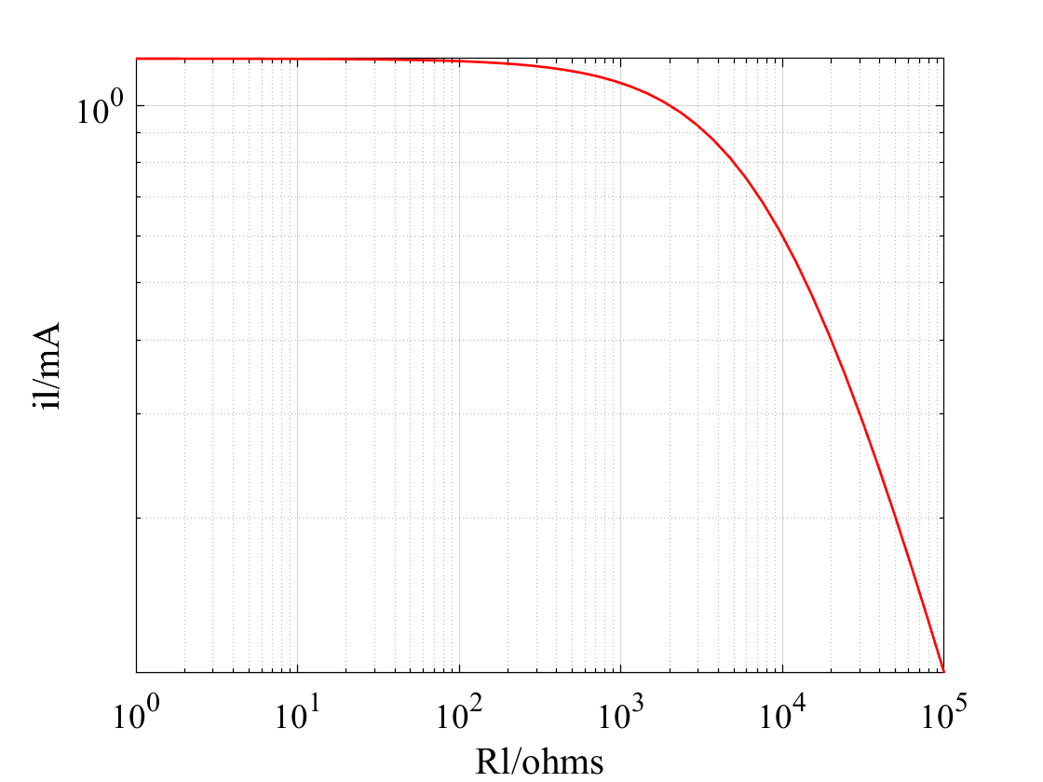
Making a constant current source
Sidetrack
#1
set(gca, 'xscale', 'log');
set(gca, 'yscale', 'log’);
grid;
% or replot it:
loglog(Rl, il)
xlabel('R_l/ohms');
ylabel('i_l/mA')
grid;
For R_{L} << R_{s}, the current looks pretty constant …
Another way to think about this: i = V₀/(R_{s}+R_{L}) is ~ constant for R_{S} >> R_{L} (because R_{S} is constant)
R_{S}
V₀
R_{L}
R_{S} dominates
“Corner”
R_{S} = R_{L}
R_{L} dominates

Slide 6
More simulations
See voltageAndCurrent.mlx, a Matlab LiveScript that explores 2 resistor series circuits in much more detail

Slide 7
Sidetrack … How dim can an LED glow?
Long
At Amgen I was tasked with comparing the sensitivities of several detectors of faint light
These $300,000-$800,000 machines measure very faint light from surface proximity assays (SPA) that convert radioactivity to light, and we had to decide which ones to buy
They wanted me to fly around the country to test these machines, carrying radioactive biological materials and doing chemistry with these highly dangerous materials
What would you do?
Would you be comfortable working in radioactive labs in foreign companies?
Would you bring your own Geiger counter or trust what you find there?
…

Slide 8
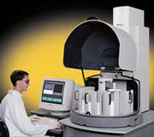
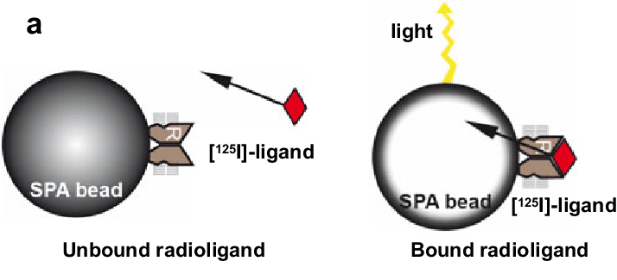
Scintillation Proximity detectors
Amgen tasked me with buying the most sensitive Scintillation Proximity detectors
These $500k machines measure faint Cerenkov light emitted by radioactive atoms
I was asked to fly around the country with radioactive materials to compare competing machines …

Slide 9
Or find another solution
Light is light – so what if I used LEDs as standard light sources, instead of radioactivity-induced Cerenkov radiation?
A 1.5V battery doesn’t turn on most LEDs (no light), and a 12V garage-door opener battery in series with a 10MΩ resistor produces I=1.2μA which was too bright.
These detectors take many seconds of exposure normally, so flashing the LED at a low duty cycle (e.g., 10msec on every second) would reduce the brightness by 100 – if the detector was linear…
Convince my client and boss that this is a better solution

Slide 10
Luminescence Reference Plate
Challenge
Commercial luminescence standards are too bright to compare and validate imaging luminometers for SPA
Solutions considered
Validate the detector with radioactive assay plates
LED’s with extremely low current (pA-nA)
Pulse the LEDs (uA at ~1e-4 duty cycle)
Neutral density filters

Slide 11
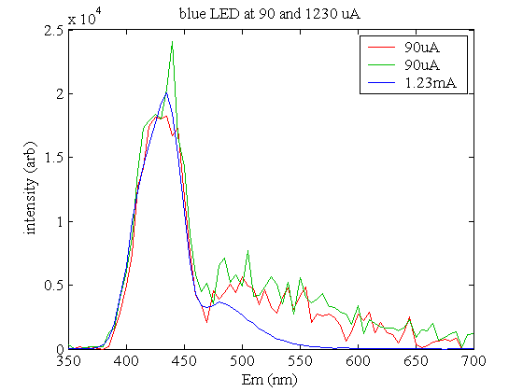
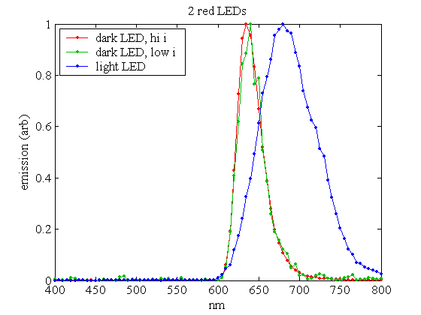
SPA Bead and LED spectra
Safire measured emission spectra of several LEDs by emission scan with deep UV excitation
LED spectra was independent of current (at least over Safire’s limited dynamic range)
Blue SPA bead Em ~ 400-480 nm
Red SPA bead Em ~ 612-618 nm

Slide 12
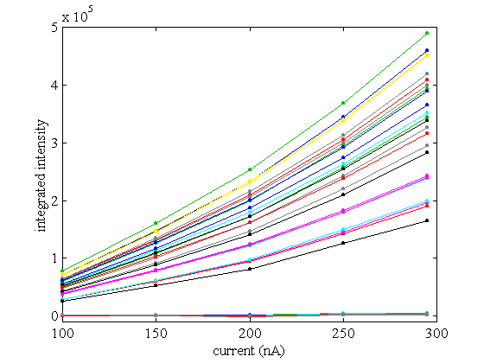
Dim LEDs
LED’s are fairly linear current-to-light transducers when above their junction voltage
Operating near the junction voltage, the output is highly sensitive voltage, temperature, etc.
The application involves integrated imaging for ~10 sec, so pulsing at low duty cycle can avoid nonlinearities.

Slide 13
Flashing lights
Electronics Workbench simulation (Demo version) shows a CMOS counter and 2 quad AND gates can generate PCM of 2^8 dynamic range.

Slide 14
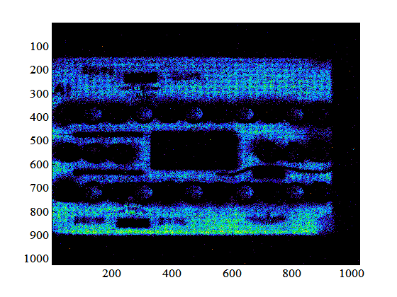
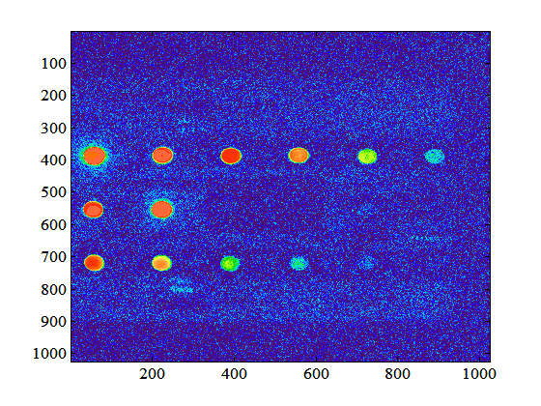
So can a microcontroller
BS2
LED
Resistor
SIP
Although a Basic Stamp (BS2) costs 100x more ($50), it can be programmed with less solder…
… and 35 lines of code:
‘ bs2 SPA Ref code
‘ 16 jan 03 BR
high 0
high 1
high 2
high 3
high 4
high 5
high 6
high 7
high 8
high 9
high 10
high 11
high 12
high 13
high 14
high 15
begin:
pulsout 0,30
pulsout 1,90
pulsout 2,270
pulsout 3,810
pulsout 4,2430
pulsout 5,7290
pulsout 6,21870
pulsout 7,65610
pulsout 8,21870
pulsout 9,7290
pulsout 10,2430
pulsout 11,810
pulsout 12,270
pulsout 13,90
pulsout 14,30
pulsout 15,10
pause 2000
goto begin

Slide 15
A Basic Stamp Code Generator
Picking optimal parameters for the code took a bit of trial and error
high 0
high 1
high 2
high 3
high 4
high 5
high 6
high 7
high 8
high 9
high 10
high 11
high 12
high 13
high 14
high 15
begin:
pulsout 0,30
pulsout 1,90
pulsout 2,270
pulsout 3,810
pulsout 4,2430
pulsout 5,7290
pulsout 6,21870
pulsout 7,65610
pulsout 8,21870
pulsout 9,7290
pulsout 10,2430
pulsout 11,810
pulsout 12,270
pulsout 13,90
pulsout 14,30
pulsout 15,10
pause 2000
goto begin
% generator for BS2 code for LED plate
% 16 jan 03 BR
for i = 0:15,fprintf('high %d\n',i); end
fprintf('begin:\n');
for i = 0:7,fprintf('pulsout %d,%d\n',i, round(29.9*3^i)); end % blue LED
for i = 8:15,fprintf('pulsout %d,%d\n',i, round(10*3^(15-i))); end % red LED
fprintf('pause 2000\ngoto begin\n');
These 5 Matlab lines generate the 35 lines of BS2 source code
It’s much easier to tweak 3 parameters in the Matlab code generator than 16 in the Stamp code.
Notes:
Could use python, C, or any other programming language to make a code generator … Today you’d do this with an Arduino like the $3 nano that you each have in the toolkit and we’ll use later. And with a tweak of syntax you could run thee for loops on the Nano .. But how might running the 5 lines behave differently than the 35 lines?

Slide 16
What did we learn?
Always try to understand what is needed, apart from what is wanted or perceived as needed
Trust physics – which told me that light is light
The detectors won’t care if it comes from LEDs or SPA if …
… the wavelength (spectra, energy) and intensities are comparable
Verify everything empirically
LEDs can produce very consistent, imperceptible (to a human) glow by pulsing them with nanoamps
12V battery + 120 MΩ = 100nA
Sidetrack in the sidetrack … 100MΩ resistors are rare because if you don’t wear gloves or wash them in solvents, your skin oils can short them …
And they also have a lot of Johnson noise (Wikipedia it).

Slide 18
Electronics Review
Key rules
Ohm’s Law: V = IR
Watt’s Law: P = VI = V²/R = I²R
Kirchoff’s Voltage Law (KVL): ΣV=0 around any loop
Kirchoff’s Current Law (KCL): ΣI=0 into or out of any node
Key concepts
V-I curves are a useful way to characterize devices
Thus are often called “characteristic curves”
Diodes are electrical “check-valves” – allow current flow in one direction
Diodes aren’t usefully characterized by “R” since the slope of the I-V curve is approximately zero or infinity almost everywhere
Resistors turn current into voltage and turn voltage sources into current sources … (please read that sentence again …)

Slide 19
Review
KVL → resistors in series are voltage dividers
V₁ = V_{o}R₁/(R₁+R₂)
Breadboards make it easier to hook parts together
Don’t jam too-big wires into them
They can fail
Not good at high frequencies
Multimeters are our principle tool for quantifying anything in electronics
They can lie to you ...
Won’t tell you AC voltage on a DC scale and visa versa
Fuses will blow if you measure a powerful voltage source while plugged into the mA or A sockets
Always check continuity before measuring resistance and the range/zero before measuring a voltage …

Slide 20
Review
We characterize electric circuits by
their topology (loops)
the components within them
Components are characterized by their I-V curves
Or approximations (e.g., piecewise linear, etc.)
Other characteristics include maximum/minimum ratings for voltage, current, power, temperature, humidity, etc.
Exceed these ratings at your own peril – the components I-V characteristics may profoundly change (➔ component failure)
We abstract Maxwell’s equations with KVL and KCL
Voltages around any loop add to zero ( )
Currents into any node sum to zero
Component characteristics + topology + KVL and KCL are generally a linear system of equations with a unique solution

Slide 21
Review
Ohm’s law is the simplest possible I-V relationship, and a good approximation for resistors
Thevenin (or Norton) equivalent circuits
Any 2-terminal component “sees” the rest of the Ohmic circuit connected to it as a voltage (or current) source in series (or parallel) with a resistance
Diodes have very non-linear I-V curves, but away from their (negative) zener breakdown voltage and forward conduction voltage “corners”, we can model them as piecewise linear (or open and short circuits)
We’ll see how other components can also be modeled Ohmically with some tricks

Slide 22
Metacognating
We’ve all got our own power supply, multimeter, breadboard, soldering iron, tools, …
So you can stumble and bumble and explore the world of electronics at home, on your own ...
Why should you want a better DC power supply?
What features should it have?

